Slide 1
QMST 5335 – FORECASTING AND SIMULATION Project 2 Overview by Dincer Konur
Department of Computer Information Systems and Quantitative Methods McCoy College of Business Administration Texas State University

Slide 2
Monte-Carlo Simulation Project
The purpose of Project 2 – Monte-Carlo Simulation project is to design a simulation model to compare different policies
It has 4 parts (corresponding to a total of 15 points)
Part A - Data generation and Analysis (2 point)
Part B – (Q,R) Policy Simulation (5 points)
Part C – (s,S) Policy Simulation (5 points)
Part D – Comparison (3 points)
The files:
There is a single ‘Project 2 – Description and Data.xlsx’ file.
It has 4 sheet, one for each part.
You will submit the same file after completing the requirements of the project on the file

Slide 3
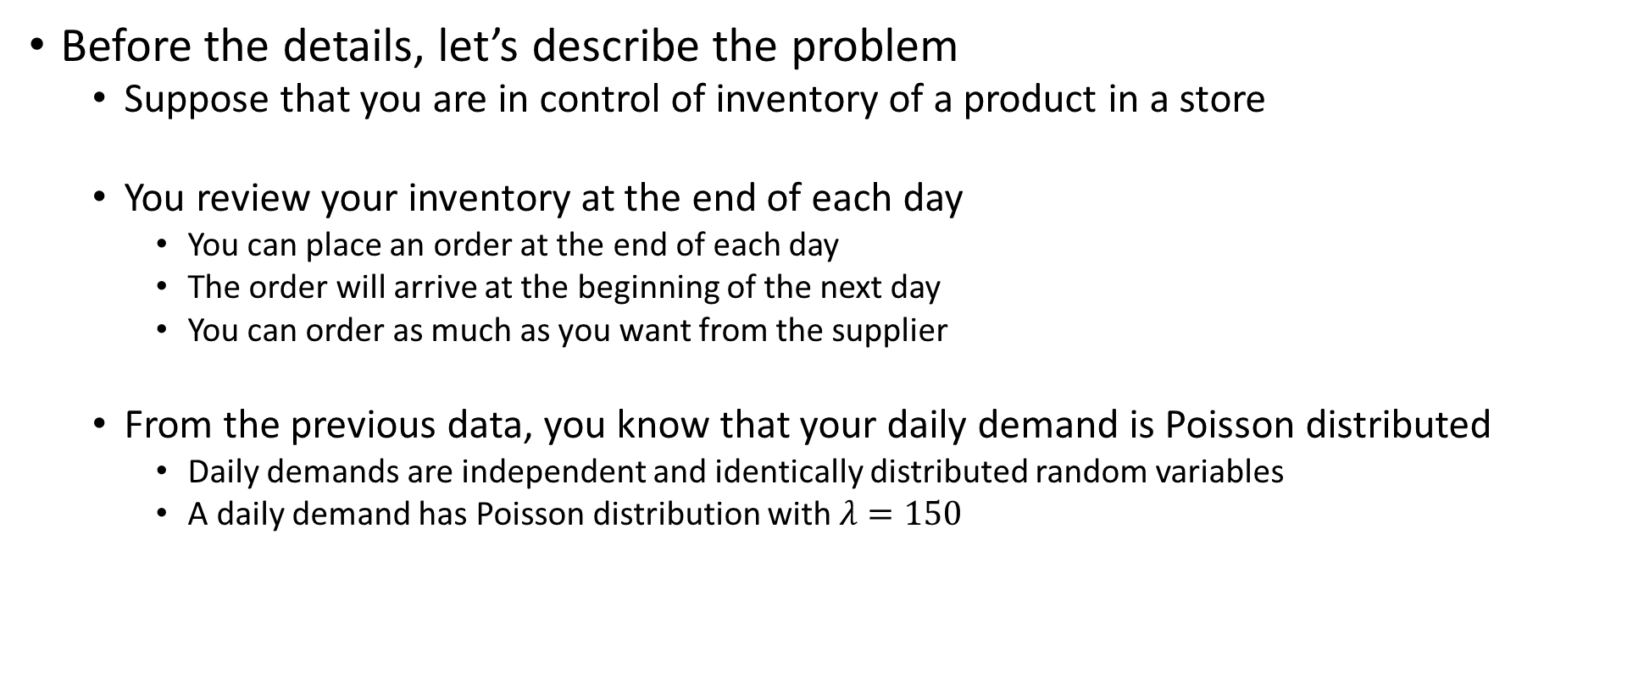
Monte-Carlo Simulation Project
Before the details, let’s describe the problem
Suppose that you are in control of inventory of a product in a store
You review your inventory at the end of each day
You can place an order at the end of each day
The order will arrive at the beginning of the next day
You can order as much as you want from the supplier
From the previous data, you know that your daily demand is Poisson distributed
Daily demands are independent and identically distributed random variables
A daily demand has Poisson distribution with $λ=150$

Slide 4
Monte-Carlo Simulation Project
Before the details, let’s describe the problem
You are considering two inventory management strategies for implementation:
(Q,R) policy:
In a (Q,R) policy, an order is placed at the end of the day if the inventory at the end of the day is less than or equal to R units; otherwise, you do not place an order
The order quantity is Q units
(s,S) policy:
In an (s,S) policy, an order is place at the end of the day if the inventory at the end of the day is less than or equal to s units; otherwise, you do not place an order
The order quantity is such that the next day’s beginning inventory is S
Note that, under each strategy, it is possible that there might be shortages
Shortage occurs when you do not have items on-hand to satisfy a customer demand
For instance, suppose your beginning inventory is 100 on a day
If total demand during the day is 75, the ending inventory is 25
If total demand during the day is 120, the ending inventory is 0 and number of shortages is 20

Slide 5
Monte-Carlo Simulation Project
(Q,R) policy: Q>0 and R>0
Inventory Position
Q
Q
R
Q
Days
t
t+1
t+2
Shortages are backordered

Slide 6
Monte-Carlo Simulation Project
(s,S) policy: s>0 and S>0
Inventory Position
S
s
Days
t
t+1
t+2
Shortages are backordered

Slide 7
Monte-Carlo Simulation Project
Inventories, Order Quantity, and Demand during a day:
Let BI(t) and EI(t) denote the beginning and ending on-hand inventory on day t
Let O(t) denote the order quantity placed at the end of day t (which arrives at the beginning of day t+1)
Let S(t) denote the number of shortages
Let D(t) be the demand during day t → a random variable
Note that:
If D(t)<=BI(t), then EI(t)=BI(t)-D(t); if D(t)>BI(t), then EI(t)=0
If D(t)<=BI(t), then S(t)=0; if D(t)>BI(t), then S(t)=D(t)-BI(t)
BI(t+1)=EI(t)+O(t)-S(t)
Beginning on-hand inventory of day t+1 is day t’s ending on-hand inventory plus order quantity (if any) minus the shortages at the end of day t (if any, which are backordered)
Note that:
Under (Q,R) policy, order quantity is O(t)=Q units if EI(t)<=R; otherwise, O(t)=0
Under (s,S) policy, order quantity is O(t)=S-EI(t)+S(t) if EI(t)<=s; otherwise, O(t)=0

Slide 8
Monte-Carlo Simulation Project
As the inventory manager, you will pick one of the following policies:
(Q,R)=(250, 50) vs. (s,S)=(50, 250)
Which one to implement based on average daily costs!
Daily costs:
Order setup cost $K/truck: to ship your order, you will use trucks from the supplier. A truck can carry C=75 units and each truck costs K=$100 regardless of how much it carries. For instance, if the order quantity is 120 units, you will need 2 trucks and bay $200 as the setup cost.
This does not change with the policy
If an order is placed at the end of day t, this cost is incurred during day t
Inventory carrying cost $h/unit: Each item remaining in the inventory at the end of a day incurs a cost
This is for carrying the item to next day, renewing its insurance, interest loss etc.
In the project, h=$5/unit
For instance, if ending on-hand inventory is 5 units at the end of day t, $25 is the inventory cost during day t
Shortage penalty cost $p/unit: If you are out of stock, and a customer comes, you promise that you will ship them the product when you get your next order
But now, you are shipping to the customer, thus you are paying for the shipment cost, to compensate the customer because he/she came to your store (spent time and money for coming to the store) and could not find the product
In the project, p=$10/unit

Slide 9
Monte-Carlo Simulation Project
Part A – Data Generation and Analysis
Your submission will have all 100 numbers in the yellow cells
Please see ‘Project 2 – Description and Data.xlsx’ file.
Place the histogram chart here.. Use the bins in orange cells
You will use Random Number Generation and Histogram tools from Data Analysis toolpack.
Answer the questions noted in the spaces given

Slide 10
Monte-Carlo Simulation Project
Please see ‘Project 2 – Description and Data.xlsx’ file.
Part B – (Q,R) policy
Formulate what is needed for results of the simulation here..
Demand will come from data generation sheet
Green cells: BI(t), EI(t), S(t), and O(t) will have functions! Formulate the correct functions in these columns.. Do it for one, drag down? Do not type in values!!!!
Formulate the cost functions here using cost parameters and the inventories/shortages/orders
See the previous slides for the relations and cost functions!
Answer the questions noted in the spaces given

Slide 11
Monte-Carlo Simulation Project
Please see ‘Project 2 – Description and Data.xlsx’ file.
Part C – (s,S) policy
Formulate what is needed for results of the simulation here..
Demand will come from data generation sheet
Green cells: BI(t), EI(t), S(t), and O(t) will have functions! Formulate the correct functions in these columns.. Do it for one, drag down? Do not type in values!!!!
Formulate the cost functions here using cost parameters and the inventories/shortages/orders
See the previous slides for the relations and cost functions!
Answer the questions noted in the spaces given

Slide 12
Monte-Carlo Simulation Project
Part D – Comparison
Important points:
For comment questions, do not make changes in the policy parameters to see how things will change…
you can play with them, however, final version should have the following (Q,R)=(250, 50) vs. (s,S)=(250, 50)
Your answer should be based on some observations you have from different policy parameters, it should be generic discussion
Green cells will have formulas! So, when blue cell values change, everything in the green cells might change..
Answer the questions noted in the spaces given

Slide 13
Monte-Carlo Simulation Project
Submission:
Submit under Project 2 assignment
Each team member needs to submit the same file
Submission is one Excel file. No other format will be graded.
Name your file: ‘Project 2– Team#’
Do not forget to put team members in Data Generation sheet.
In the submission window, each student should explain which parts are completed by which members. This is to assure that each team member contributes to the project.

